Slide 1
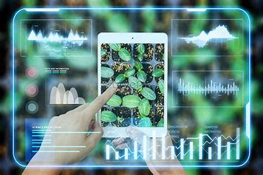
Project Title: Plant Disease Classifier
Presented by: Yousef Abdelnasser Ahmed Title: AI Engineer Under the Academic Supervision of: Shabab Mobtakeron

Slide 2
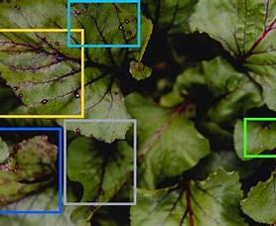
Introduction
What is the Plant Disease Classifier? A deep learning-powered application that detects and classifies plant diseases from leaf images.
Purpose: To assist farmers and agricultural experts in identifying plant diseases early to prevent crop loss.

Slide 3
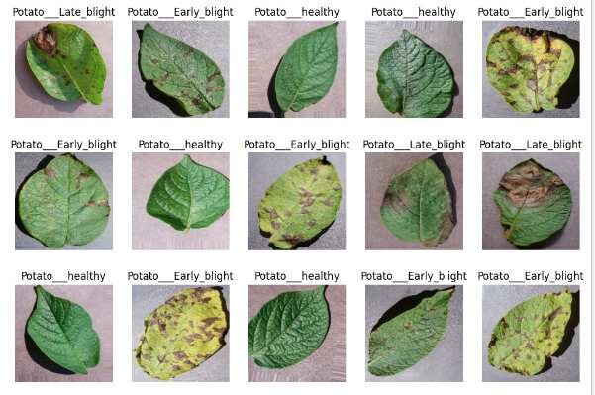
Dataset
Name: PlantVillage Dataset Source: https://www.kaggle.com/datasets/abdallahalidev/plantvillage-dataset Total Categories: 38
Examples:
Tomato___Leaf_Mold
Potato___Early_blight
Apple___Black_rot
Strawberry___healthy

Slide 4
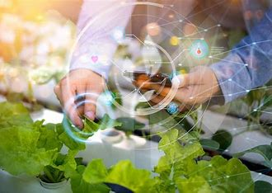
Tools & Technologies
Python
TensorFlow / Keras
Streamlit
JSON (label encoding)
OpenCV

Slide 5
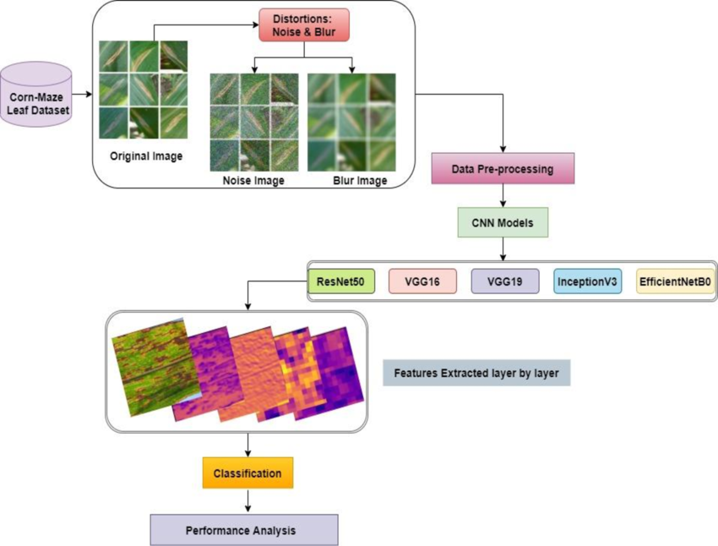
Model Architecture
CNN-based architecture
Input Size: 224x224
Optimizer: Adam
Loss Function: Categorical Crossentropy
Training:
Trained on labeled leaf images
Data augmentation used to improve generalization

Slide 6
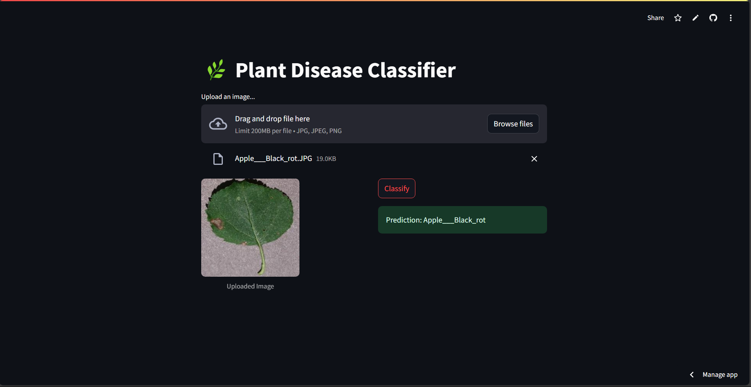
Application Interface
Upload an image of a plant leaf
Click "Classify"
Output: Predicted disease class
Demo Screenshot: (Include screenshot from app with prediction)

Slide 7
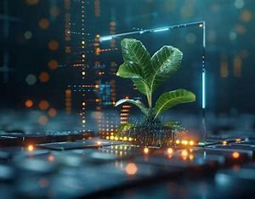
Future Improvements
Integrate Transfer Learning (e.g. MobileNetV2)
Deploy to cloud (Streamlit Share, Heroku, etc.)
Add confidence scores and real-time webcam capture

Slide 8
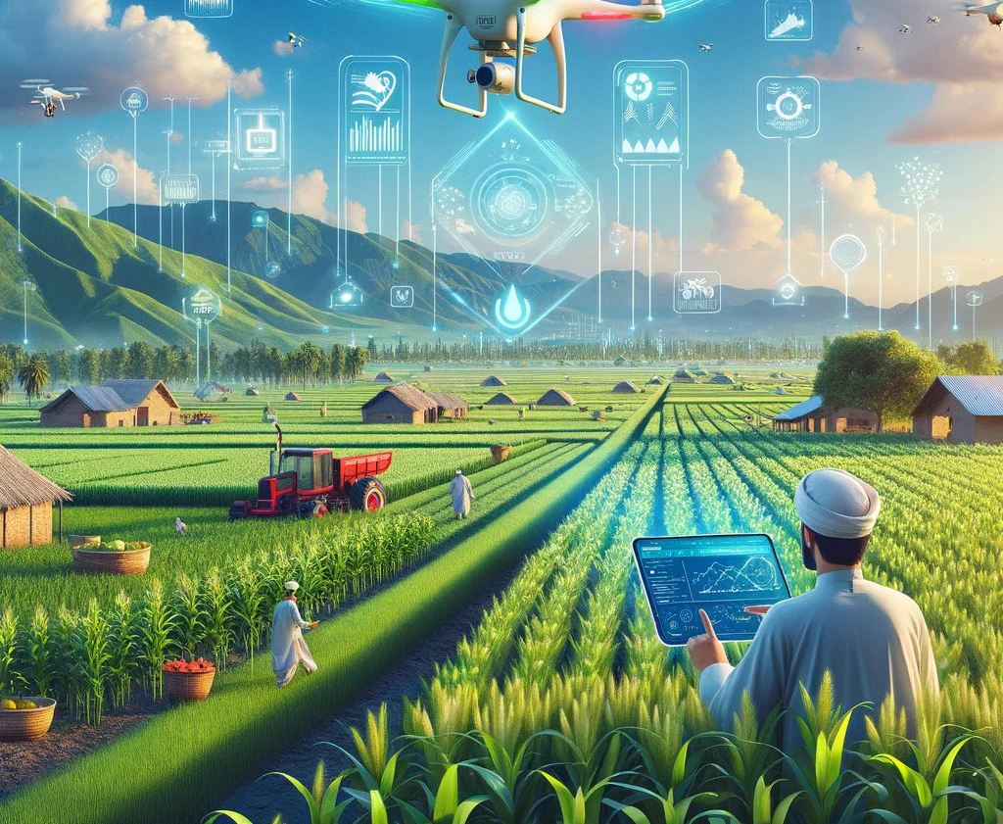
Conclusion
The project demonstrates the power of AI in agriculture
Early detection of plant disease can save crops and improve food security
Next step: improve performance and deploy for real-world use

Slide 9
Thank You

